Slide 1
Frigate

Slide 2
Agenda
What We Do?
Fiori based Vendor Portal: Why?
AIRDIT: Your Next Gen Support Partner/ Our Innovations
High Level Offerings
Buyer Apps
Quality Apps
Vendor Apps
Next what?
Appendix
Contact Us
Copyright AIRDIT Software. All rights reserved

Slide 3
What we do?
Current date SAP System ROI
AIRDIT target for SAP ROI
Vision towards Digital Transformation
6/10
8/10
Mobility through SAP Fiori
Low
High
Low
High
How do we rate ourselves?
HANA Cloud Platform capability
9/10
SAP TECHNOLOGY
9/10
AGILITY
9/10
Custom Addons to reduce license cost
FLEXIBILITY
8/10
INNOVATION
9/10
Ensure ROI of S4HANA investments
PRICING
Copyright AIRDIT Software. All rights reserved

Slide 4
Why Fiori based Vendor Portal?
Inline with SAP’s vision of User Interface
SAP Supported UI/ Future updates will make enable rich User Experience
No need to keep Android, IOS developers for UI support
No External Integration Tool required
Single tool to address your Workflow, Transactional and Analytics needs
Reports and Dashboard option possible through same tool
Label printing and bar code scanning possible wherever applicable
Minimum Infra Requirement
Future support cost will be lesser
Uniformity across organization in terms of usages
Notification possibilities: SMS, Email, browser, push and whatsapp(third party api) notifications
Copyright AIRDIT Software. All rights reserved

Slide 5
High Level Offerings
Buyer
Vendor
Schedules
Request for Quotation
Vendor Communication
Vendor Performance Management/ Rating
Empanelment
Vendor Queries
Reports and Dashboards
Dispatch Against Schedule
Submit Quotations
PO Confirmation/ ASN
Vendor Invoice
Catalogues
Quality Certificates Upload
Reports and Dashboards
Transparency
Efficiency
VP
Visibility
Quality
Miscellaneous
Quality Issues Management
RM Specification
Audit Reports and Closure Letter
Quality Certificates Approval
Reports and Dashboards
Minutes of Meeting
Documents Exchange
Shared Drive
Finance Team App
Vendor Master Creation Automation
Operations

Slide 6
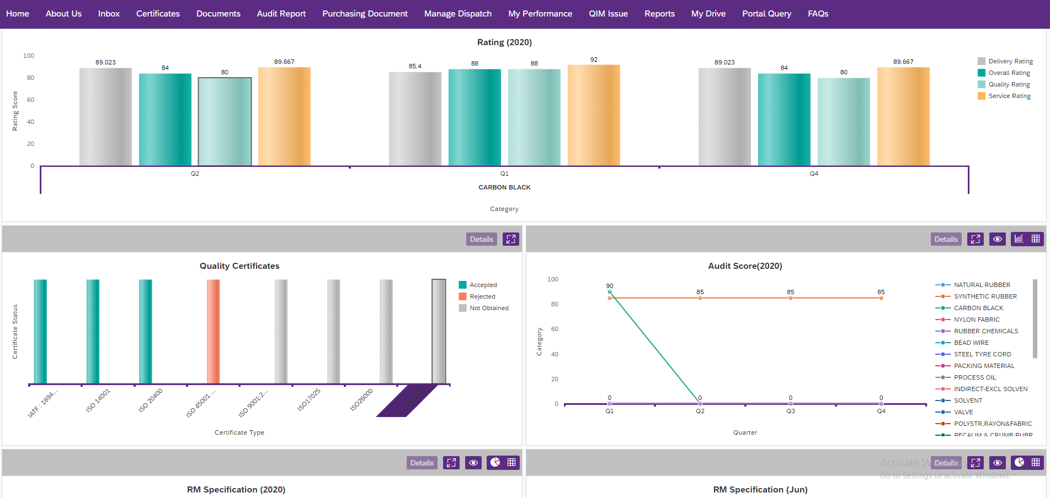
Vendor Apps
Refer to Appendix for App Screenshots
Vendor Apps
Submit RM specification
Submit Quotation
Product Catalogue
Manage Invoice
Manage my Quality Certificates
Document Sharing
Audit Report
PO Display/ Confirmation/ ASN
Manage Dispatch
Contact Us
My Performance
Schedule
RM Specification
Reports
Dashboards
Copyright AIRDIT Software. All rights reserved
Technical Environment:
SAP ECC, Suite on HANA, S4 HANA

Slide 7
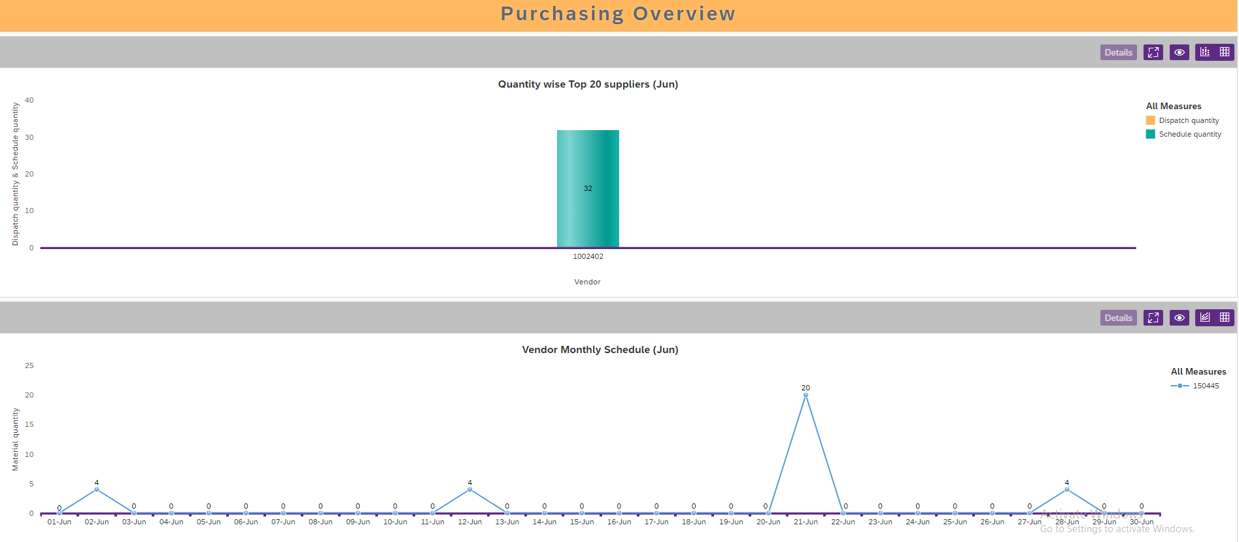
Buyer Apps
Refer to Appendix for App Screenshots
Schedule creation
Manage schedule
Display dispatch
Empanelment Request Approval
Empanelment Initiation
Document Sharing
Catalogue Display
Request for Quotation
Invoice Approval
Send Vendor Rating
Manage Vendor Performance Improvement Plan
Vendor Queries
Reports
Dashboards
Copyright AIRDIT Software. All rights reserved
Technical Environment:
SAP ECC, Suite on HANA, S4 HANA

Slide 8
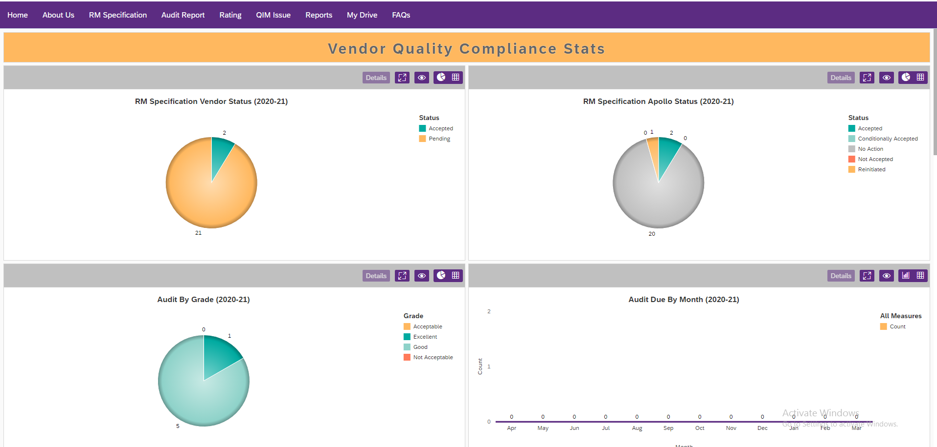
Quality Apps
Refer to Appendix for App Screenshots
Quality Apps
Audit Report and Closure Letter
Quality Issues
Raw Material Specification
Quality Certificates Approval
Reports
Dashboards
Copyright AIRDIT Software. All rights reserved
Technical Environment:
SAP ECC, Suite on HANA, S4 HANA

Slide 9
What’s Next
Future Apps
End to End Vendor Invoice Management
Q1
2021
More Reports and Dashboards
Q3
2021
Export/ Import Functionality
Reverse and Forward Auction
Q2
2021
Q4
2021

Slide 10
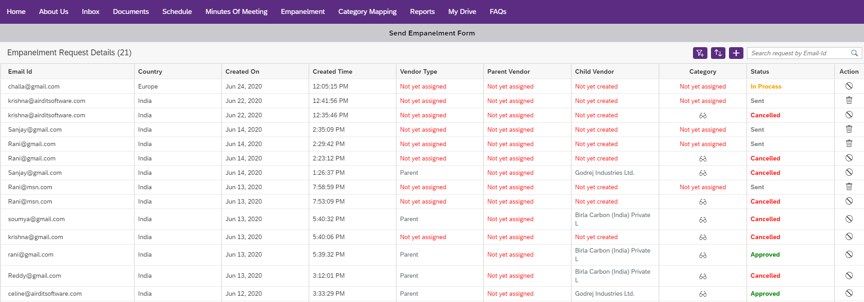
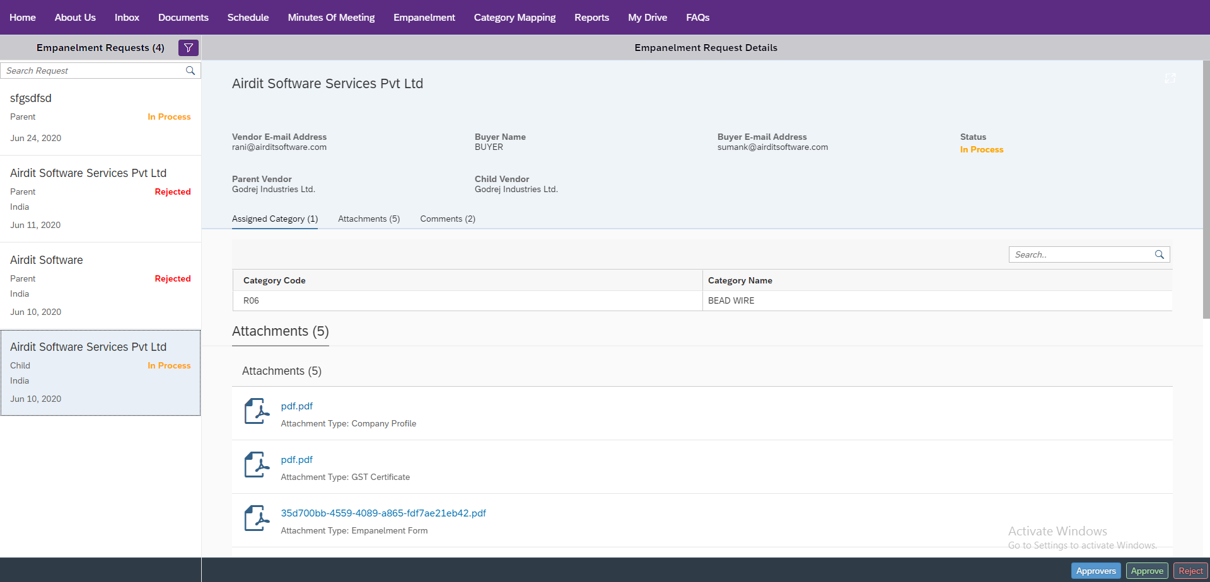
Appendix: Vendor Portal Screenshots
Empanelment
Copyright AIRDIT Software. All rights reserved
Copyright AIRDIT Software. All rights reserved

Slide 11
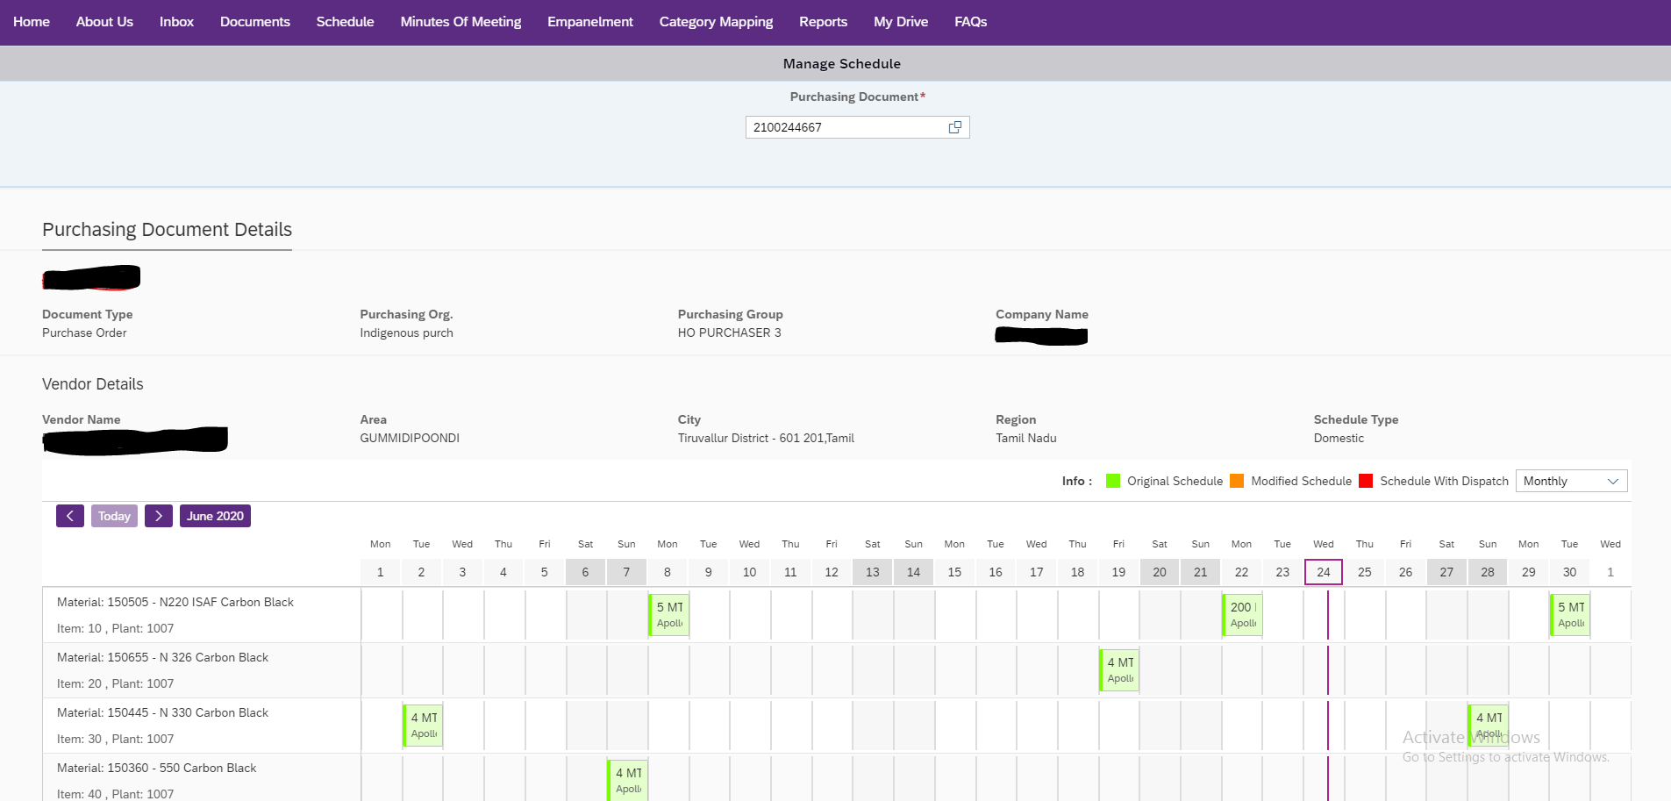
Appendix: Vendor Portal Screenshots
Manage Schedule
Copyright AIRDIT Software. All rights reserved
Copyright AIRDIT Software. All rights reserved

Slide 12
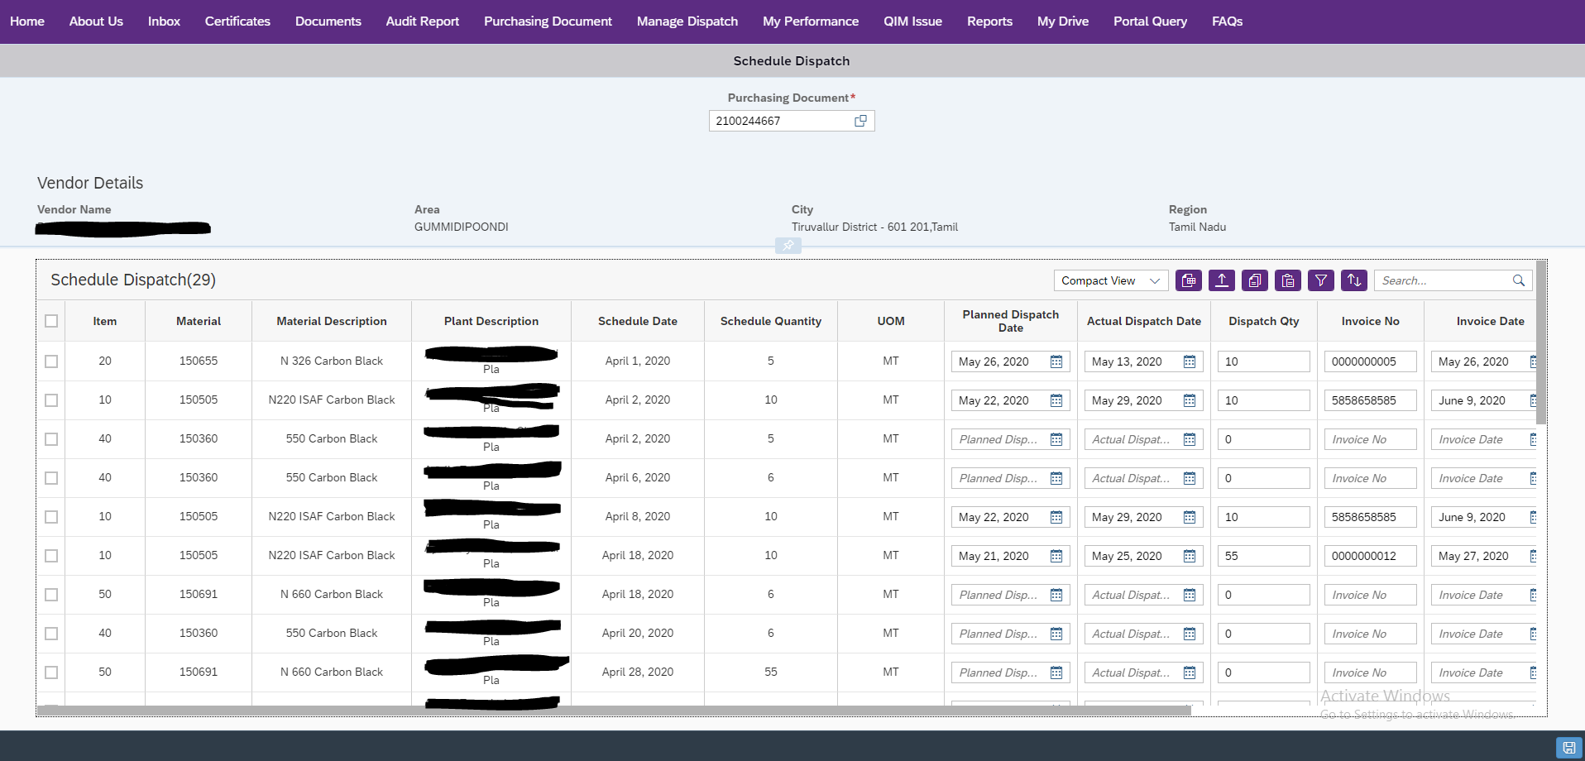
Appendix: Vendor Portal Screenshots
Manage Dispatch
Copyright AIRDIT Software. All rights reserved
Copyright AIRDIT Software. All rights reserved

Slide 13
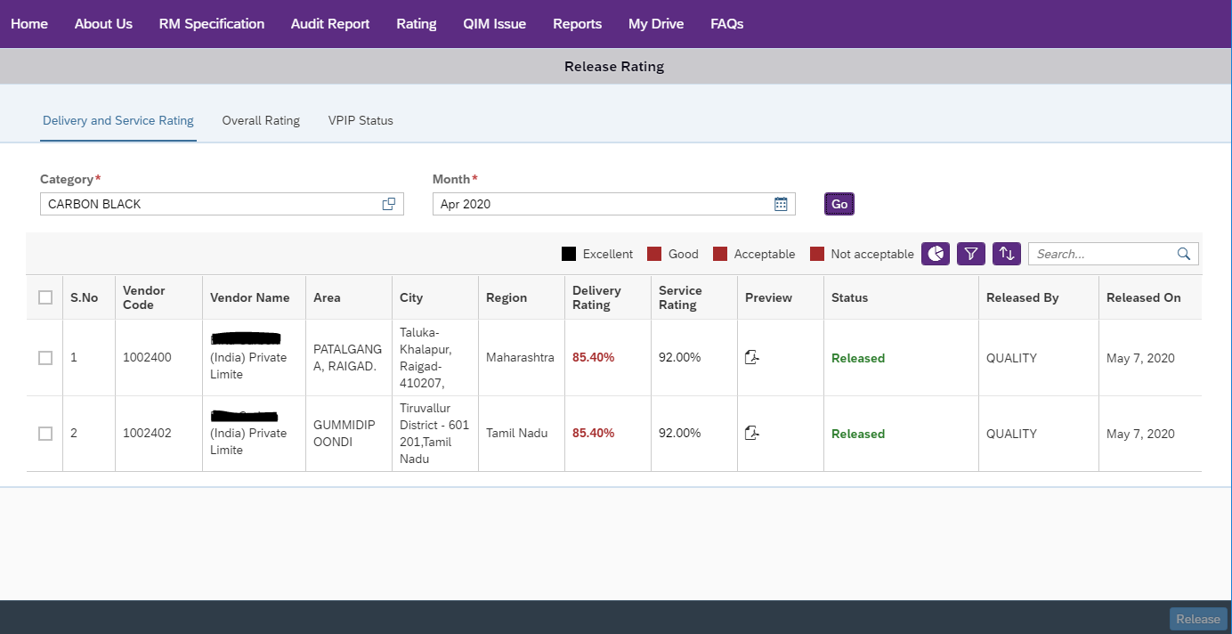
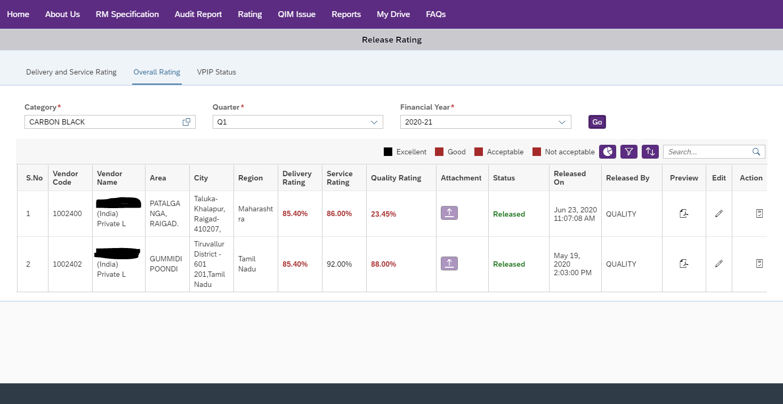
Appendix: Vendor Portal Screenshots
Rating: Delivery & Service / Overall Rating
Copyright AIRDIT Software. All rights reserved
Copyright AIRDIT Software. All rights reserved

Slide 14
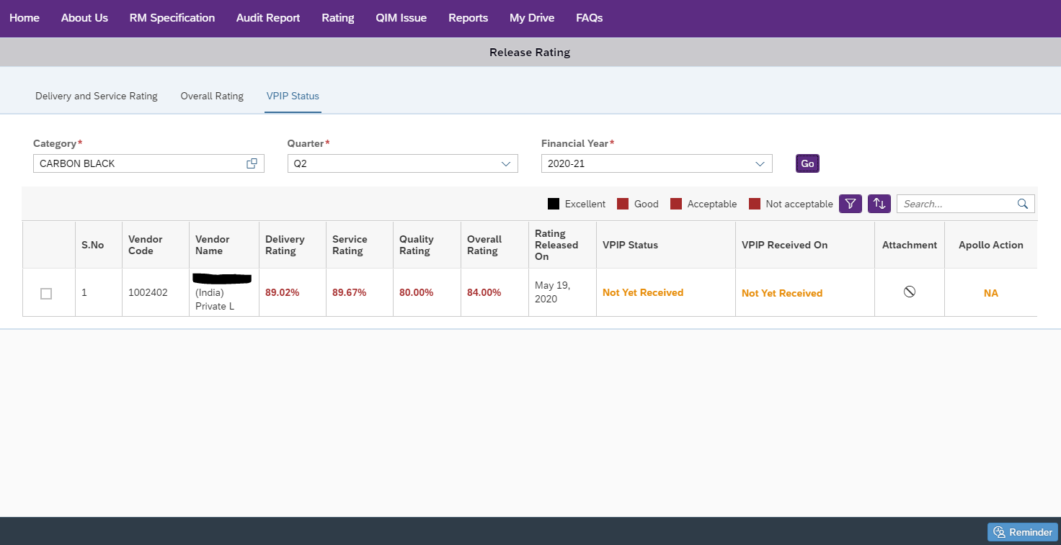
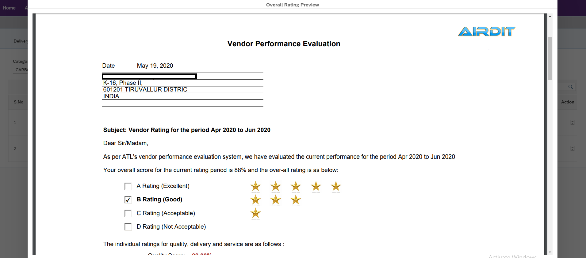
Appendix: Vendor Portal Screenshots
Rating: Delivery & Service / Overall Rating
Copyright AIRDIT Software. All rights reserved
Copyright AIRDIT Software. All rights reserved

Slide 15
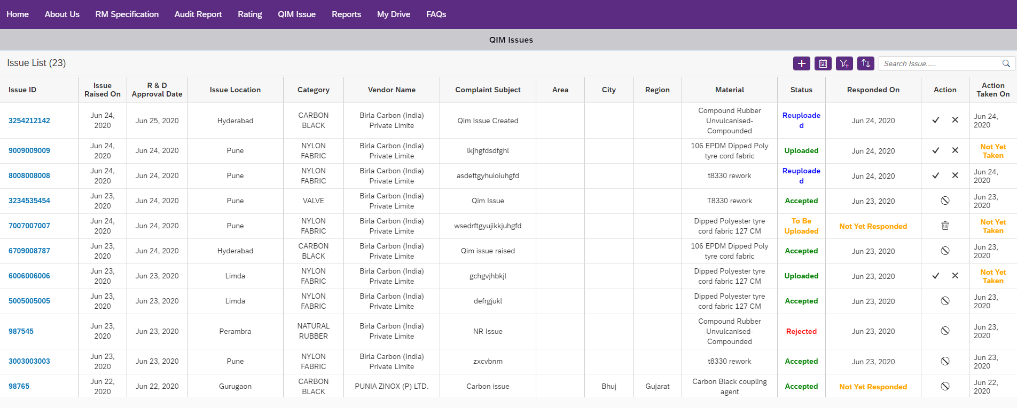
Appendix: Vendor Portal Screenshots
Quality Information Management
Copyright AIRDIT Software. All rights reserved
Copyright AIRDIT Software. All rights reserved

Slide 16
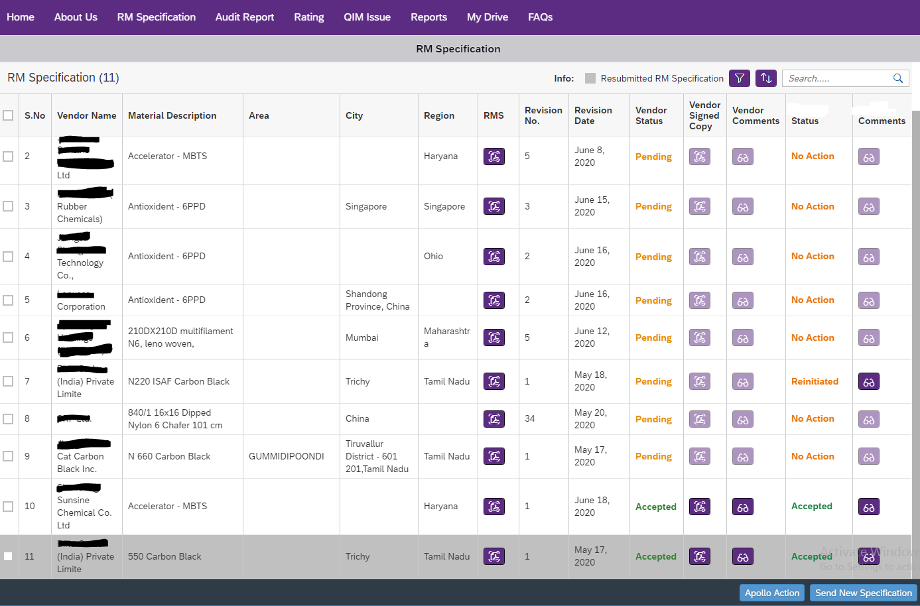
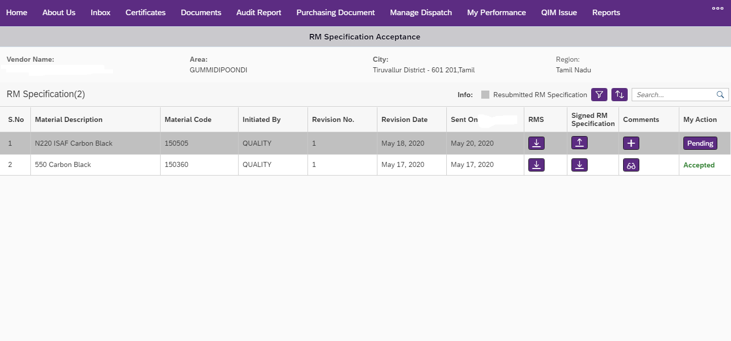
Appendix: Vendor Portal Screenshots
Raw Material Specifications
Copyright AIRDIT Software. All rights reserved
Copyright AIRDIT Software. All rights reserved

Slide 17
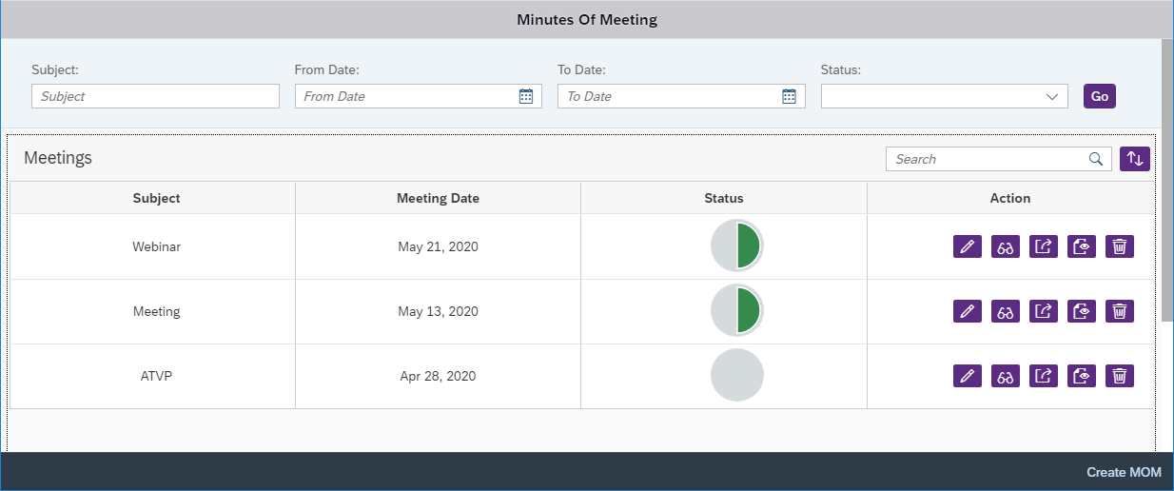
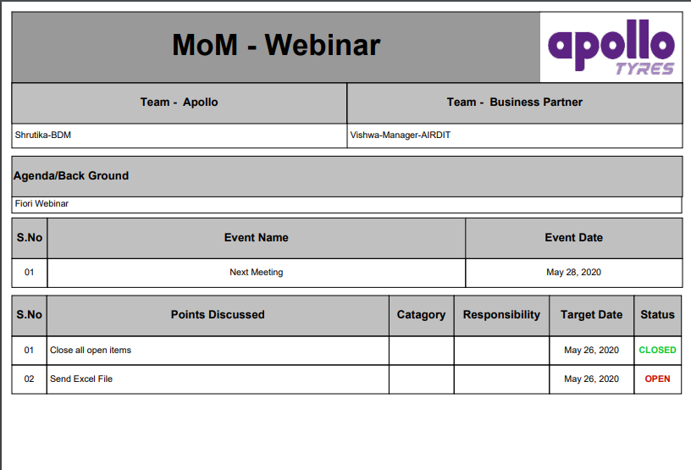
Appendix: Vendor Portal Screenshots
MOM
Copyright AIRDIT Software. All rights reserved
Copyright AIRDIT Software. All rights reserved

Slide 18
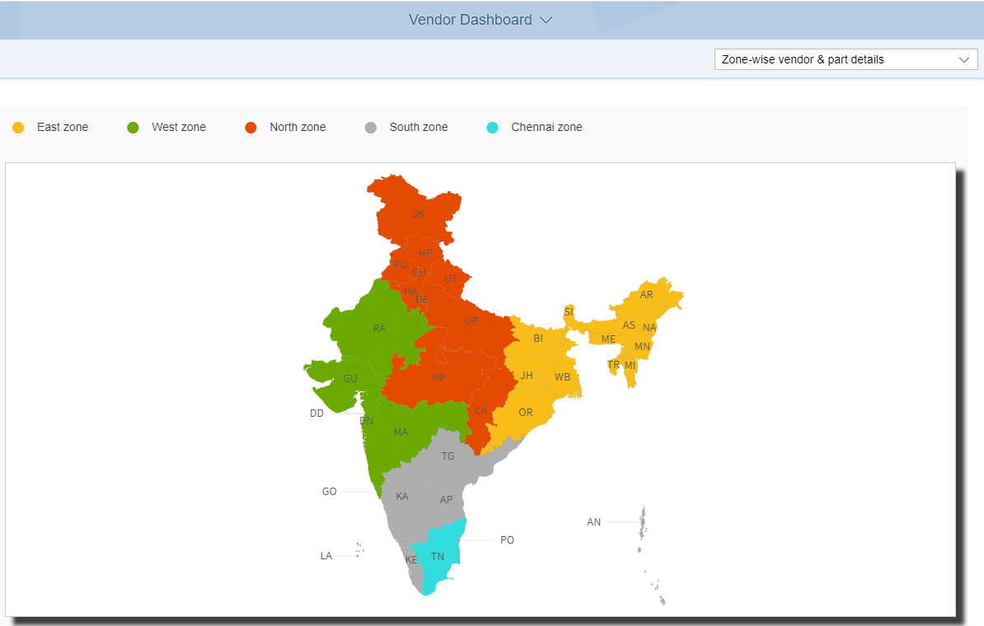
Appendix: Vendor Portal Screenshots
Map Based Reports
Copyright AIRDIT Software. All rights reserved

Slide 19
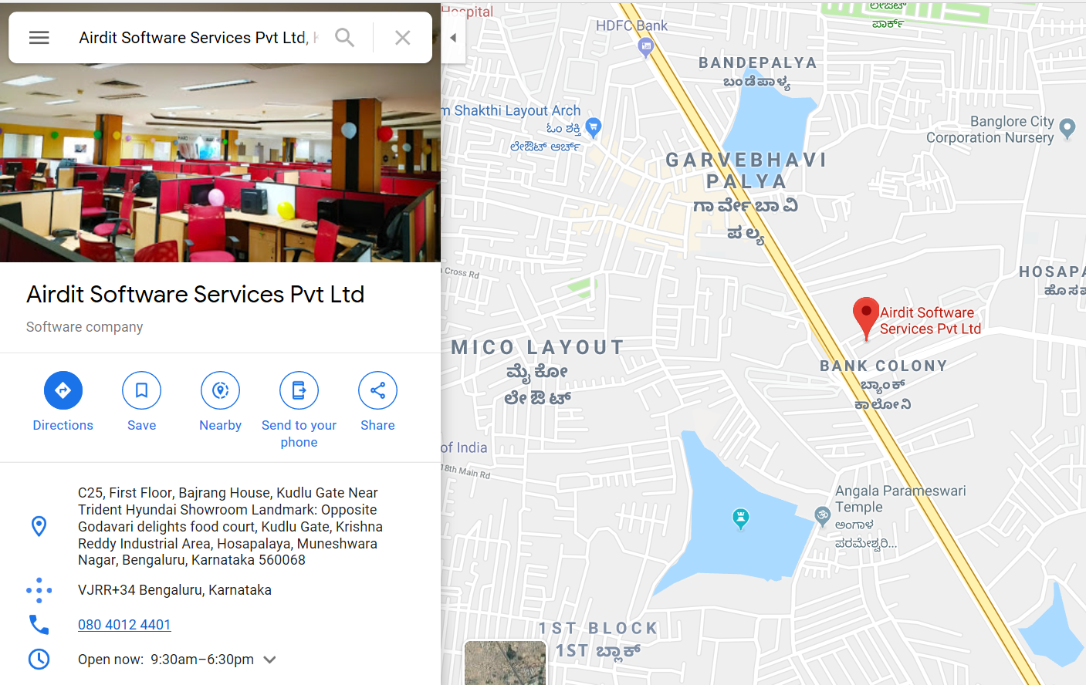
Contact Us
sales@airditsoftware.com
www.airditsoftware.com
+91-7765867678
Copyright AIRDIT Software. All rights reserved

